Slide 1
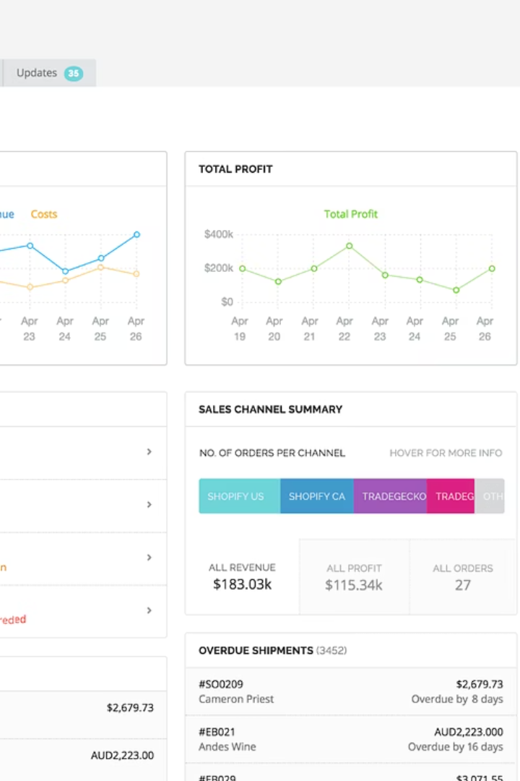
E-Commerce Order Management System
This presentation outlines the development of a robust E-Commerce Order Management System, a capstone project for the INSY 8311 - Database Development with PL/SQL course. The system aims to streamline order processing, enhance data integrity, and provide comprehensive auditing capabilities for modern e-commerce platforms. We will delve into the problem statement, project objectives, system design, and the advanced PL/SQL features implemented to achieve these goals.

Slide 2

Addressing Critical Pain Points in Order Management
Problem Definition
Manual order processing is a significant bottleneck in e-commerce operations, leading to substantial delays and an increased risk of human errors. This inefficiency directly impacts customer satisfaction and operational costs. Furthermore, the lack of stringent business rule enforcement results in data inconsistencies, complicating inventory management and sales reporting. The limited traceability of order actions hinders effective auditing and impairs data-driven decision-making processes.
The current context involves rapidly growing e-commerce platforms facing an escalating volume of online orders. The target users for this system include managers who require oversight, sales teams needing accurate order status, inventory staff for precise stock control, and customers who expect timely and accurate order fulfillment.

Slide 3
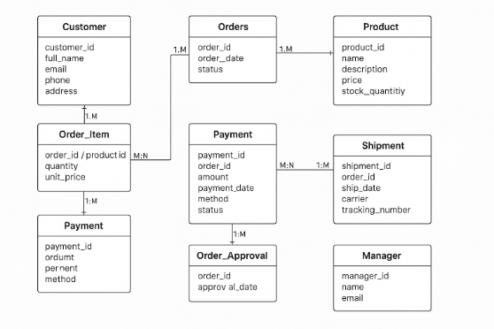


Slide 4




Strategic Objectives for System Enhancement
Automate Workflow
Enforce Business Rules
Streamline the entire order processing workflow, from order placement to shipment, minimizing manual intervention.
Implement robust PL/SQL procedures and triggers to strictly enforce all defined business rules, ensuring data consistency and integrity.
Track & Audit Actions
Improve Decision-Making
Develop comprehensive logging mechanisms to track and audit all user actions, providing a clear trail for accountability and compliance.
Integrate the system with Management Information System (MIS) functions to provide real-time data for informed decision-making and operational insights.
These objectives are designed to transform the current manual system into an efficient, reliable, and intelligent order management solution. By automating key processes and enforcing stringent controls, the project aims to deliver a system that not only resolves existing challenges but also supports future growth and scalability.

Slide 5
Mapping the E-commerce Order Lifecycle
Business process modeling defines the operational flow of the system. The scope encompasses the full order lifecycle management, from initial customer interaction to final delivery and post-sales activities. This ensures a holistic view of how orders are handled and processed.
Key Actors
Modeling Tools
Process Highlights
Customer: Initiates orders.
Draw.io is utilized for Business Process Model and Notation (BPMN) diagrams, featuring swimlanes to clearly delineate responsibilities and interactions between different actors within the system.
The model emphasizes real-time validation of order details, automated inventory checks to prevent overselling, and necessary manager approvals for exceptional cases, ensuring smooth and controlled order progression.
Sales System: Manages order details.
Inventory System: Tracks stock levels.
Payment Gateway: Processes transactions.
Warehouse: Handles fulfillment.
Manager: Provides approvals and oversight.

Slide 6





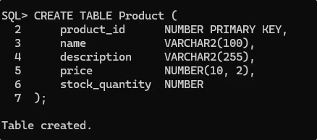
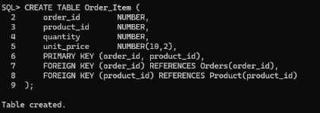


Detailed BPMN Diagram for Order Processing
Customer Swimlane
System Swimlane
Warehouse Swimlane
Initiates the order process by placing an order through the e-commerce platform.
Handles real-time validation, inventory checks, payment processing, and order routing.
Responsible for picking, packing, and shipping the products.
Manager Swimlane
Involved in approval processes for specific order conditions, ensuring oversight.
The BPMN diagram vividly illustrates the flow of tasks, decisions, and gateways within the order management system. Key decision points include 'Stock Available?' to check inventory status and 'Manager Approval?' for specific order types. This detailed mapping supports critical Management Information System (MIS) functions, enabling real-time process tracking and comprehensive visibility into the order fulfillment lifecycle.

Slide 7





Conceptualizing the Data Structure
The logical data model serves as the blueprint for the database design, outlining the key entities and their relationships. This model is crucial for ensuring data integrity, reducing redundancy, and supporting efficient data retrieval within the e-commerce order management system.
Product & Order_Item
Customer & Manager
Product defines the goods, while Order_Item captures details of specific products within an order, linking orders to individual items.
Entities representing the individuals interacting with the system, capturing personal and role-specific data. Manager records are linked to approvals.
Orders
The central entity, containing main order details and linking to customers, order items, payments, and shipments.
Approval
Records manager actions and approvals for orders that require special authorization, providing an audit trail.
Payment & Shipment
Dedicated entities for transaction details and shipping information, ensuring a one-to-one relationship with specific orders.
All entities are meticulously normalized to the Third Normal Form (3NF) to eliminate data redundancy and improve data integrity. For instance, the Customer entity has a one-to-many relationship with Orders, meaning one customer can place multiple orders. Orders have a one-to-many relationship with Order_Items, and Order_Items have a many-to-many relationship with Products. This ensures efficient data management and scalability.

Slide 8
System Implementation and Core Features
The e-commerce order management system is built upon a robust Oracle database, leveraging industry-standard tools for development and management. The focus during implementation was to establish a solid foundation for data integrity and system functionality.
Schema Design
All necessary tables and their corresponding constraints, including Primary Keys (PK), Foreign Keys (FK), NOT NULL, and CHECK constraints, were meticulously defined to ensure data integrity.
Database Setup
The ecommerce database was configured as the central data repository.
1
2
3
4
Tooling
Data Validation
Oracle SQL Developer facilitated schema creation and PL/SQL coding, while OEM (Oracle Enterprise Manager) provided advanced database administration capabilities.
Sample test data was meticulously generated and inserted into the tables to thoroughly validate the schema design and constraint enforcement.
This foundational work ensures that the system is not only functional but also adheres to strict data governance principles, setting the stage for advanced PL/SQL features to be layered on top.

Slide 9



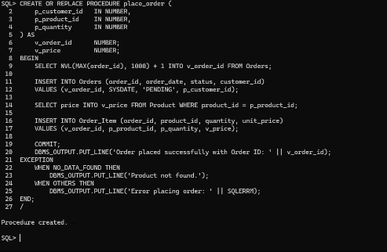
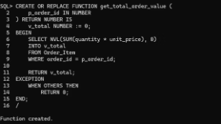
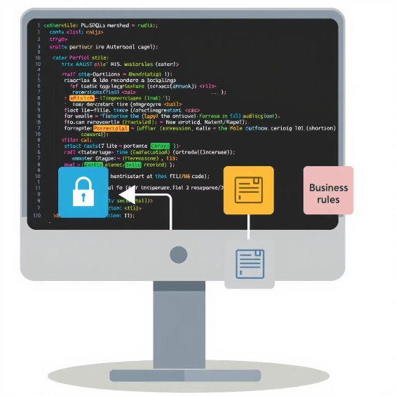
Leveraging Advanced PL/SQL for Business Logic
Advanced PL/SQL features are critical for enforcing complex business rules, ensuring data security, and providing comprehensive auditing capabilities. These components are integral to the system's robustness and reliability.
Triggers
Implemented to prevent order processing operations on weekends and specified public holidays. A dedicated reference table stores holiday dates, ensuring dynamic and accurate enforcement.
Packages
Developed to encapsulate related functions and procedures for managing orders and enforcing specific business rules. This modular approach enhances code reusability and maintainability.
Auditing Mechanism
A robust auditing system logs every significant user action, recording the user ID, action performed, timestamp, and the outcome (allowed or denied). This provides critical data for compliance and operational analysis.
These advanced PL/SQL components are meticulously designed to handle intricate business requirements, ensuring that the system operates efficiently, securely, and in full compliance with defined operational policies.

Slide 10
Project Conclusion and Future Roadmap
The E-Commerce Order Management System successfully automates the order processing workflow and secures data integrity using robust PL/SQL features. Triggers and packages effectively enforce complex business logic, while the comprehensive auditing mechanism provides valuable insights for Management Information System (MIS) functions.
1
2
Return Processing
AI Forecasting
Integrate a module for efficient handling of product returns and customer reviews.
Incorporate AI for demand forecasting and inventory optimization.
3
4
Logistics APIs
Mobile Interface
Integrate with external logistics APIs for real-time shipping updates.
Develop a mobile application for customers to track orders and manage accounts.
These recommendations and future work initiatives aim to extend the system's capabilities, further enhancing its value proposition for e-commerce platforms by improving user experience and operational efficiency.

